Slide 1

P peline
The Data
Machine Learning II: Regression, Decision Trees & Naïve Bayes
© Jennifer Mankoff
The Data Pipeline; HCII; Spring 2015
Slides modified & borrowed from Carolyn Rosé
Want to go deeper? http://see.stanford.edu/see/lecturelist.aspx?coll=348ca38a-3a6d-4052-937d-cb017338d7b1

Slide 2
Plan for today
Introduce some algorithms
Logistic Regression
Decision Trees
Naïve Bayes
Talk about math behind them; key assumptions

Slide 3
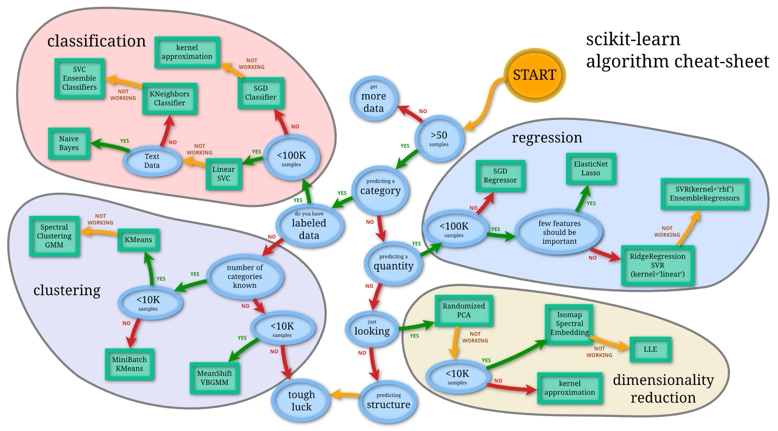
Selecting algorithms
http://www.quora.com/What-are-the-advantages-of-different-classification-algorithms

Slide 4
Selecting algorithms
http://www.quora.com/What-are-the-advantages-of-different-classification-algorithms

Slide 5
Regression: Predicting a Quantity
y
Observed y for x_{i}
Random Error for x_{i}
e_{i}
b₁
Predicted for x_{i}
b₀
x
x_{i}
x
The individual random error terms e_{i} have a mean of zero
Notes:
This works in two dimensions
Xx get kirstin’s help improving the clarity of how I present all of the regression material.

Slide 6
Least Squares Regression
b₀ and b₁ must minimize
y
Observed Value of y for x_{i}
e_{i}
Estimated Slope = b₁
Predicted Value for x_{i}
Intercept = b₀
x
Notes:
Note we can replace y-cap with b0 – b1x

Slide 7
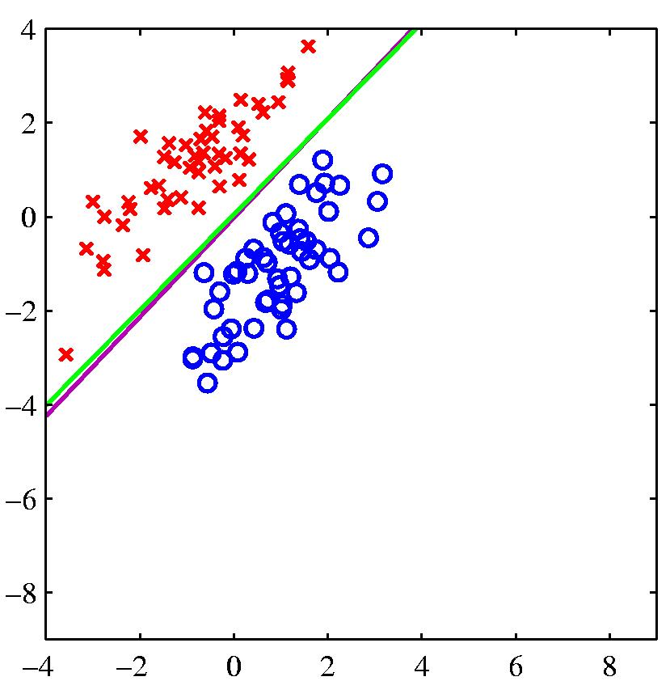
Estimated Logistic Regression Model
Given training examples:
x_{1..i} in R^{n} [our feature vectors]
And labels
y_{1..i} in R
we want to learn w^{T}x + b + e
(that’s just matrix speak for α + βX + e)
Notes:
This works in two dimensions

Slide 8
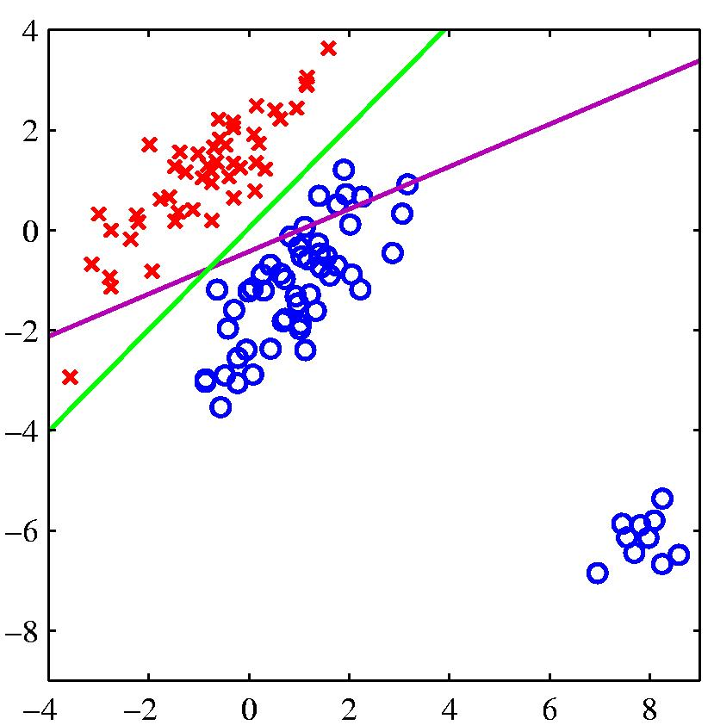
Problems with using least squares for classification
logistic regression
least squares regression
If the right answer is 1 and the model says 1.5, it loses, so it changes the boundary to avoid being “too correct”

Slide 9
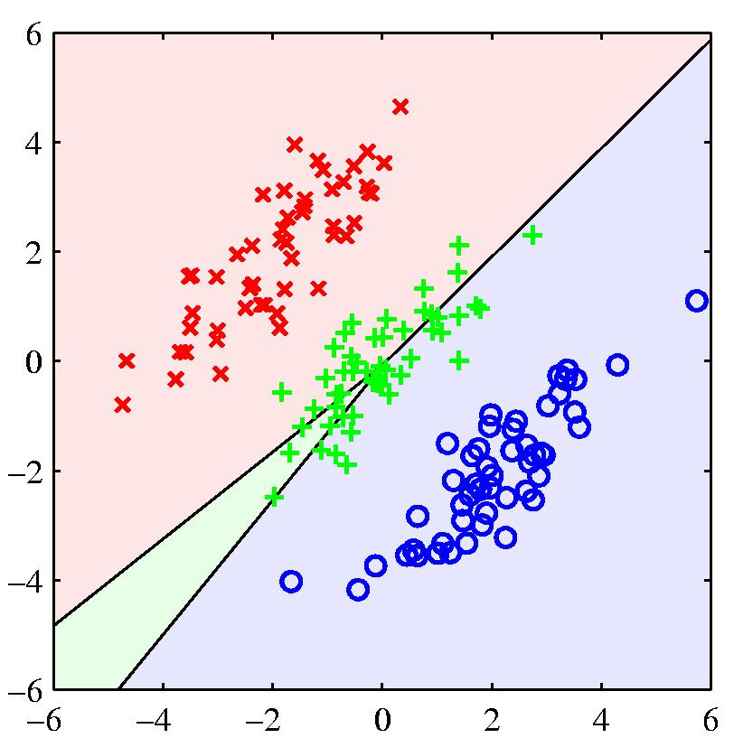
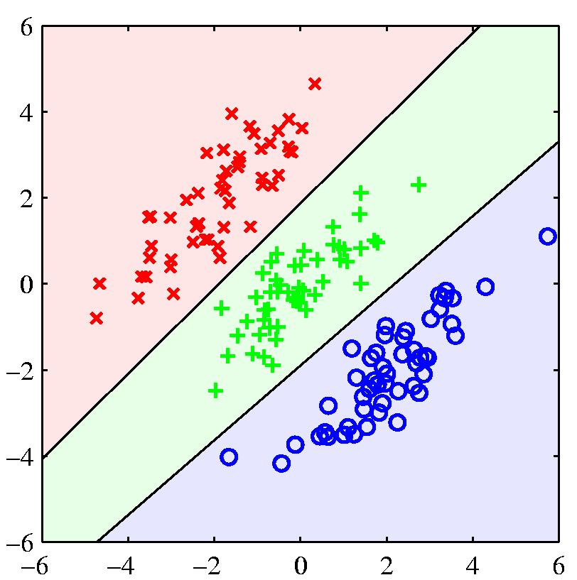
Another example where least squares regression gives poor decision surfaces

Slide 10
Goal of Logistic Regression
Key idea: instead of predicting a number in R, predict the probability of a class label.
p+ = P(class is positive|features) p- = P(class is negative|features)
Base p on the projection that gives the best separation of the classes.

Slide 11
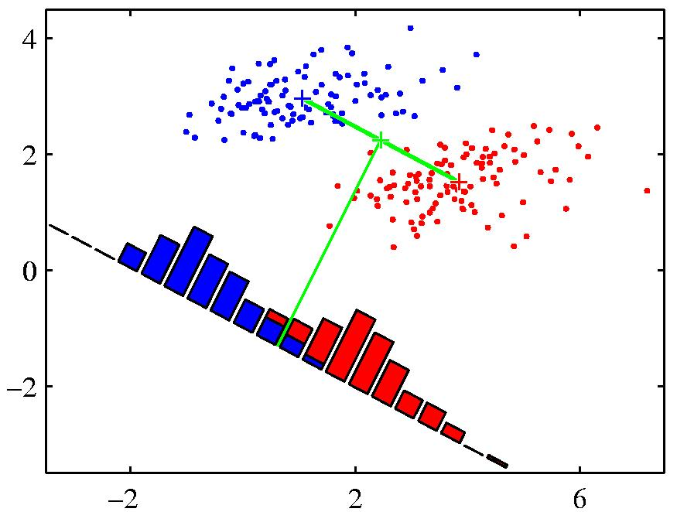
What do we mean by ‘best separation’?
When projected onto the line joining the class means, the classes are not well separated.
Slides from www.cs.toronto.edu/~hinton
Notes:
An obvious direction to choose is the direction of the line joining the class means. But if the main direction of variance in each class is not orthogonal to this line, this will not give good separation

Slide 12
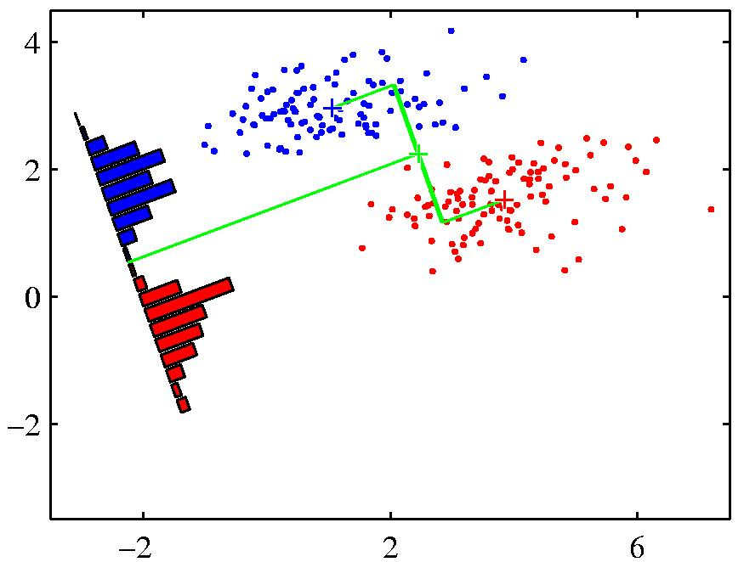
What do we mean by ‘best separation’?
When projected onto the line joining the class means, the classes are not well separated.
Fisher’s Discriminant: A better choice
Slides from www.cs.toronto.edu/~hinton
Notes:
An obvious direction to choose is the direction of the line joining the class means. But if the main direction of variance in each class is not orthogonal to this line, this will not give good separation

Slide 13
Animal Outcomes
Will an animal be successfully placed (or euthanized?)
1 Placed
2 Euthanized

Slide 14
How do you pick your features?
Too many can lead to overfitting [but feature selection can help with this]
Too few can fail to capture the information needed for prediction
http://selfiecity.net/selfiexploratory/

Slide 15
Practical Example: Animal Data
Your goal is to predict the outcome for an animal based on its characteristics
We don’t want everything in the fusion table
Can’t use the outcome measure
Some features may introduce bias (such as OutcomeMonth). What do we know that could predict the outcome at intake time?
Some features too complex to be useful (IntakeDate)

Slide 16
Preparing the Data
Need an array containing the observed frequencies of outcomes, something like this:
Animal type | Breed | Age | … | Outcome
Dogs | Laborador | >6yrs | … | euthanized
Cats | … | … | … | adopted
Notes:
Need to write code to create this table.

Slide 17
Extracting Features
A good starting set of features:
features = ['AnimalType', 'IntakeMonth', 'Breed', 'Age', 'Sex', 'SpayNeuter’, 'Size', 'Color', 'IntakeType']

Slide 18
Extracting Features
We need to extract column numbers for those features
ncols = len(cols)
for i in np.arange(ncols):
try:
# if in the list store the location
features.index(cols[i])
use_data.append(i)
…
X = all_data[:, use_data]
y = all_data[:, out_index]
Notes:
(so we can select just those columns out of the array)

Slide 19
Extracting Features
We need to extract column numbers for those features
ncols = len(cols)
for i in np.arange(ncols):
try:
# if in the list store the location
features.index(cols[i])
use_data.append(i)
…
X = all_data[:, use_data]
y = all_data[:, out_index]
A quick mechanism for looking something up in an array. Frequently useful. Here it lets us decide which outcome to increment.
Notes:
(so we can select just those columns out of the array)

Slide 20
Extracting Features
We need to extract column numbers for those features
ncols = len(cols)
for i in np.arange(ncols):
try:
# if in the list store the location
features.index(cols[i])
use_data.append(i)
…
X = all_data[:, use_data]
y = all_data[:, out_index]
Here we use it to collect information
Notes:
(so we can select just those columns out of the array)

Slide 21
Extracting Features
We need to extract column numbers for those features
ncols = len(cols)
for i in np.arange(ncols):
try:
# if in the list store the location
features.index(cols[i])
use_data.append(i)
except ValueError:
…
This catches the case where the outcome wasn’t found
Notes:
(so we can select just those columns out of the array)

Slide 22
Removing unwanted features
We need to extract column numbers for those features
ncols = len(cols)
for i in np.arange(ncols):
try:
# if in the list store the location
features.index(cols[i])
use_data.append(i)
…
X = all_data[:, use_data]
y = all_data[:, out_index]
Selects only those columns used in all_data for X, and the outcome variable for y (what we will predict)
Notes:
(so we can select just those columns out of the array)

Slide 23
Removing unwanted classes
y[y=="No Show"] = "Other"
y[y=="Missing Report Expired"] = "Other"
y[y=="Found Report Expired"] = "Other”
…
y[y=="Trap Neuter/Spay Released"] = "Other"
y[y=="Transferred to Rescue Group"] = "Other"
y[y==u'Foster']="Other"
Notes:
(so we can select just those columns out of the array)
(otherwise too many things to select among…)

Slide 24
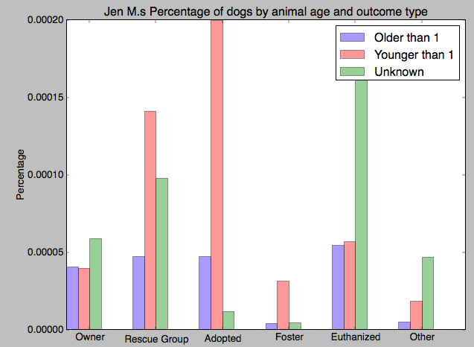
Don’t forget to plot it
Can output to a file and use a program of your choice
Or use pyplot

Slide 25
Modeling Logistic Regression
We want to decide a class
The "logit" model solves these problems: ln[p/(1-p)] = α + βX + e
p is the probability that the event Y occurs, p(Y=1)
p/(1-p) is the "odds ratio"
ln[p/(1-p)] is the log odds ratio, or "logit"
WhitHead: www.appstate.edu/~whiteheadjc/service/logit/logit.ppt

Slide 26
More:
The logistic distribution constrains the estimated probabilities to lie between 0 and 1.
The estimated probability is: Since ln[p/(1-p)] = α + βX + e
WhitHead: www.appstate.edu/~whiteheadjc/service/logit/logit.ppt

Slide 27
More:
The logistic distribution constrains the estimated probabilities to lie between 0 and 1.
The estimated probability is: Since ln[p/(1-p)] = α + βX + e p = 1/[1 + exp(-α - β X +e)]
WhitHead: www.appstate.edu/~whiteheadjc/service/logit/logit.ppt

Slide 28
More:
The logistic distribution constrains the estimated probabilities to lie between 0 and 1.
The estimated probability is: Since ln[p/(1-p)] = α + βX + e p = 1/[1 + exp(-α - β X +e)]
Called
if you let α + β X =0, then p = .50
as α + β X gets really big, p approaches 1
as α + β X gets really small, p approaches 0
WhitHead: www.appstate.edu/~whiteheadjc/service/logit/logit.ppt

Slide 29
Assigning a class
Definition:
Squeezes the real line into [0,1]
Differentiable: (nice exercise)

Slide 30
Soft threshold interpretation
If y> 0, σ(y) goes to 1 very quickly.
If y<0, σ(y) goes to 0 very quickly.
Notes:
Figure 18 from Russell and Norvig.

Slide 31
Probabilistic Interpretation
The sigmoid can be interpreted in terms of the class odds p+/(1-p+)
Exercise: Show the following implication for the class odds:
Therefore the log class odds.
Notes:
p is the probability that the event Y occurs, p(Y=1)
p/(1-p) is the “ratio"
ln[p/(1-p)] is the log odds ratio, or "logit"
P(1+exp(-y)) = 1
P + pexp(-y) = 1
Pexp(-y) = 1-p
p(e^-y)(e^y) = 1-p (e^y)
p/(1-p) = e^y

Slide 32
Logistic regression
Since
we know
so we can estimate w by
minimizing training error
Notes:
P(1+exp(-y)) = 1
P + pexp(-y) = 1
Pexp(-y) = 1-p
p(e^-y)(e^y) = 1-p (e^y)
p/(1-p) = e^y

Slide 33
Minimizing the error (learning) is just search over the weight space
Searching for global minimum
Incrementally descend along gradient Δ(w)
Update weights using something like:
w_{j} = w_{i} + η Δ(w)
Manipulate step size (η) based on various factors
Typically proportional to E(w, b) -- gradient descent
We can define a convex cost function! (only one minimum)
Notes:
‘kick the duck’ (simulated annealing) ; damped over time – simulated annealing if you have a non-convex function
http://www.quora.com/Convex-Optimization/Why-is-Convex-Optimization-such-a-big-deal-in-Machine-Learning

Slide 34
Minimizing Error
we want to minimize an error term based on w
When E(w) is minimized we have our best fit
Notes:
P(1+exp(-y)) = 1
P + pexp(-y) = 1
Pexp(-y) = 1-p
p(e^-y)(e^y) = 1-p (e^y)
p/(1-p) = e^y

Slide 35
Minimizing Error
we want to minimize an error term based on w
When E(w) is minimized we have our best fit
a ‘loss’ function whose definition can vary (affects the details of what we learn)
Notes:
an upper bound on mis-classification error

Slide 36
Minimizing Error
The actual correct class (the label, based on our training data)
we want to minimize an error term based on w
When E(w) is minimized we have our best fit

Slide 37
Minimizing Error
we want to minimize an error term based on w
When E(w) is minimized we have our best fit
The predicted class (x.w)

Slide 38
Minimizing Error
we want to minimize an error term based on w
When E(w) is minimized we have our best fit
a ‘regularization term’ which penalizes model complexity

Slide 39
Minimizing Error
we want to minimize an error term based on w
When E(w) is minimized we have our best fit
A parameter which affects R’s impact on the search

Slide 40
Gradient Descent: Linear vs Logistic
Linear regression: y= α + β₁*X + β₂ *W + β₃ *Z… = ϴ^{T}x
Logistic regression:
Algorithm the same (just solving for diff)
Repeat until the difference in error is small:
At each step change w based on the error and the step size η
w_{j} = w_{i} - η Δ(w)

Slide 41
Gradient Descent: Linear vs Logistic
Linear regression: y= α + β₁*X + β₂ *W + β₃ *Z… = ϴ^{T}x
Logistic regression:
Algorithm the same (just solving for diff)
Repeat until the difference in error is small:
Notes:
Based on a common loss function
Theta is just a matrix representation of the weights

Slide 42
Implementing Gradient Descent
Loops over the entire data set S {
At each step change w based on the error and the step size η (the learning rate)
w_{j} = w_{i} - η Δ(w)
simultaneously update all the weights for training instance X_{j}, y_{j}
where p_{w}(x^{(i)}) =
}

Slide 43
Main algorithm
# weights -- the list weights currently assigned to the features (an empty array that will be filled in by this function. # X -- the array containing cases to predict from, # labels -- the ground truth y values. # step -- the rate controller for changing the weights. # lam -- the regularization parameter. Something you could play with on a large data set is what value to use for this. you would want to do that by picking an optimization set and trying lots of lam values (from 0 to 1) on that optimization set. # iterations -- defaults to 1 for stochastic gradient descent, but can be higher in standard gradient descent.
def gradient_descent(self, weights, X, y_labels, step=0.1, lam=0.1, iterations=1): m, n=X.shape # iterate over the rows to train the model on the same data for i in xrange(iterations): for r in xrange(_MAX_ROWS): old_weights = weights weights = old_weights + step*(self.loss_func(X[r], old_weights - y_labels[r]))*X[r] #add in regularization term weights = weights - lam*2.*step*old_weights return weight

Slide 44
Main algorithm
# weights -- the list weight scurrently assigned to the features (an empty array that will be filled in by this function. # X -- the array containing cases to predict from, # labels -- the ground truth y values. # step -- the rate controller for changing the weights. # lam -- the regularization parameter. Something you could play with on a large data set is what value to use for this. you would want to do that by picking an optimization set and trying lots of lam values (from 0 to 1) on that optimization set. # iterations -- defaults to 1 for stochastic gradient descent, but can be higher in standard gradient descent.
def gradient_descent(self, weights, X, y_labels, step=0.1, lam=0.1, iterations=1): m, n=X.shape # iterate over the rows to train the model on the same data for i in xrange(iterations): for r in xrange(_MAX_ROWS): old_weights = weights weights = old_weights + step*(self.loss_func(X[r], old_weights - y_labels[r]))*X[r] #add in regularization term weights = weights - lam*2.*step*old_weights return weight
We are using a fairly ‘dumb’ decision about when to stop here

Slide 45
Main algorithm
# weights -- the list weight scurrently assigned to the features (an empty array that will be filled in by this function. # X -- the array containing cases to predict from, # labels -- the ground truth y values. # step -- the rate controller for changing the weights. # lam -- the regularization parameter. Something you could play with on a large data set is what value to use for this. you would want to do that by picking an optimization set and trying lots of lam values (from 0 to 1) on that optimization set. # iterations -- defaults to 1 for stochastic gradient descent, but can be higher in standard gradient descent.
def gradient_descent(self, weights, X, y_labels, step=0.1, lam=0.1, iterations=1): m, n=X.shape # iterate over the rows to train the model on the same data for i in xrange(iterations): for r in xrange(_MAX_ROWS): old_weights = weights weights = old_weights + step*(self.loss_func(X[r], old_weights - y_labels[r]))*X[r] #add in regularization term weights = weights - lam*2.*step*old_weights return weight
This is the key aspect of the algorithm – updating the weights

Slide 46
Main algorithm
# weights -- the list weight scurrently assigned to the features (an empty array that will be filled in by this function. # X -- the array containing cases to predict from, # labels -- the ground truth y values. # step -- the rate controller for changing the weights. # lam -- the regularization parameter. Something you could play with on a large data set is what value to use for this. you would want to do that by picking an optimization set and trying lots of lam values (from 0 to 1) on that optimization set. # iterations -- defaults to 1 for stochastic gradient descent, but can be higher in standard gradient descent.
def gradient_descent(self, weights, X, y_labels, step=0.1, lam=0.1, iterations=1): m, n=X.shape # iterate over the rows to train the model on the same data for i in xrange(iterations): for r in xrange(_MAX_ROWS): old_weights = weights weights = old_weights + step*(self.loss_func(X[r], old_weights - y_labels[r]))*X[r] #add in regularization term weights = weights - lam*2.*step*old_weights return weight
Here’s where we use the loss function to decide how that update should happen .
# loss function for logistic regression def loss_func(self, x, weights):
return 1.0 (1.+math.e**(-1.0*np.dot(x,weights)))

Slide 47
Doing this for animal eg
nrows = len(all_data)
percent = len(X)/20
X_opt = X[:percent, :]
y_opt = y[:percent]
X_rest = X[percent:, :]
y_rest = y[percent:]

Slide 48
Dividing your data
nrows = len(all_data)
percent = len(X)/20
X_opt = X[:percent, :]
y_opt = y[:percent]
X_rest = X[percent:, :]
y_rest = y[percent:]
All the hard work is done with X_opt and y_opt.

Slide 49
Dividing your data
nrows = len(all_data)
percent = len(X)/20
X_opt = X[:percent, :]
y_opt = y[:percent]
X_rest = X[percent:, :]
y_rest = y[percent:]
Only use the rest of the data for validation at the very end (you will use this to report numbers in Byte5)

Slide 50
Recall: Training Classifiers
Training Time
Training Data Set
f₁ | f₂ | f₃ | … | Label
A | 42 | 17 | … | Yes
C | 78 | 25 |  | No
X | 32 | 4 |  | Yes
Learner
Sensors
Classifier
This is X
This is y

Slide 51
Training Classifiers
Training Data Set
f₁ | f₂ | f₃ | … | Label
A | 42 | 17 | … | Yes
C | 78 | 25 |  | No
X | 32 | 4 |  | Yes
Learner
Sensors
Classifier
dc = DummyClassifier(strategy='most_frequent',random_state=0)
dc = dc.fit(X_train, y_train)

Slide 52
Training Classifiers
Training Data Set
f₁ | f₂ | f₃ | … | Label
A | 42 | 17 | … | Yes
C | 78 | 25 |  | No
X | 32 | 4 |  | Yes
Learner
Sensors
Classifier
dc = DummyClassifier(strategy='most_frequent',random_state=0)
dc = dc.fit(X_opt, y_opt)

Slide 53
Using Kfold Validation
skf = cross_validation.StratifiedKFold(y_opt, 10)
for train, test in skf:
X_train, X_test = X_opt[train], X_opt[test]
y_train, y_test = y_opt[train], y_opt[test]
# train the classifier
dc = dc.fit(X_train, y_train)
# test the classifier
dc_pred = dc.predict(X_test)
# calculate metrics relating how well they did
dc_accuracy = metrics.accuracy_score(
y_test, dc_pred)
dc_acc_scores = dc_acc_scores + [dc_accuracy]
We loop and select a different fold for traininng/testing each time from the optimization set

Slide 54
Using Kfold Validation
skf = cross_validation.StratifiedKFold(y_opt, 10)
for train, test in skf:
X_train, X_test = X_opt[train], X_opt[test]
y_train, y_test = y_opt[train], y_opt[test]
# train the classifier
dc = dc.fit(X_train, y_train)
# test the classifier
dc_pred = dc.predict(X_test)
# calculate metrics relating how well they did
dc_accuracy = metrics.accuracy_score(
y_test, dc_pred)
dc_acc_scores = dc_acc_scores + [dc_accuracy]
Train aclassifier with the training set. Here we are using a toolkit, not rolling our ouwn

Slide 55
Using Kfold Validation
skf = cross_validation.StratifiedKFold(y_opt, 10)
for train, test in skf:
X_train, X_test = X_opt[train], X_opt[test]
y_train, y_test = y_opt[train], y_opt[test]
# train the classifier
dc = dc.fit(X_train, y_train)
# test the classifier
dc_pred = dc.predict(X_test)
# calculate metrics relating how well they did
dc_accuracy = metrics.accuracy_score(
y_test, dc_pred)
dc_acc_scores = dc_acc_scores + [dc_accuracy]
Test it with the testing set (one of the 10 folds)

Slide 56
Using Kfold Validation
skf = cross_validation.StratifiedKFold(y_opt, 10)
for train, test in skf:
X_train, X_test = X_opt[train], X_opt[test]
y_train, y_test = y_opt[train], y_opt[test]
# train the classifier
dc = dc.fit(X_train, y_train)
# test the classifier
dc_pred = dc.predict(X_test)
# calculate metrics relating how well they did
dc_accuracy = metrics.accuracy_score(
y_test, dc_pred)
dc_acc_scores = dc_acc_scores + [dc_accuracy]
Calculate metrics such as accuracy. We can capture them in an array and print them out along the way or compute an avg at the end

Slide 57
Real Work: Selecting Features and Algorithms
But you only know if you’re making progress if you compare them
diff = np.mean(first_acc_scores) - np.mean(second_acc_scores)
t, prob = scipy.stats.ttest_rel(dc_acc_scores, gnb_acc_scores)

Slide 58
Real Work: Selecting Features and Algorithms
Topic of today’s lecture
But you only know if you’re making progress if you compare them
diff = np.mean(first_acc_scores) - np.mean(second_acc_scores)
t, prob = scipy.stats.ttest_rel(dc_acc_scores, gnb_acc_scores)
Is the mean different in accuracy large?

Slide 59
Real Work: Selecting Features and Algorithms
Topic of today’s lecture
But you only know if you’re making progress if you compare them
diff = np.mean(first_acc_scores) - np.mean(second_acc_scores)
t, prob = scipy.stats.ttest_rel(dc_acc_scores, gnb_acc_scores)
Is it significant? A regular t-test can answer this

Slide 60
ALWAYS do this on X_opt
If features are based on observations over your whole set of data…
Notes:
Unfair advantage – you know more about the data than your system!
Your estimate will be overly optimistic

Slide 61
Finding Features
If features are based on observations over your whole set of data…
At training time the features will perform better than they should because they were design based on the training data
At testing time, you will have used ‘omniscience’ to build features
Notes:
Unfair advantage – you know more about the data than your system!
Your estimate will be overly optimistic

Slide 62
Features to avoid
Oracles
Identical/Interdependent features
Irrelevant features

Slide 64
Order of Thursday’s presentations / Quiz?

Slide 65
Selecting algorithms
http://www.quora.com/What-are-the-advantages-of-different-classification-algorithms

Slide 66
Selecting algorithms
http://www.quora.com/What-are-the-advantages-of-different-classification-algorithms

Slide 67
From today’s reading
 | Decision Trees | Naïve Bayes | SVM* | Rule Learners
Accuracy in general | ** | * | **** | **
Speed of learning given f and n | *** | **** | * | **
Tolerance of missing values | *** | **** | **** | **
Tolerance of irrelevant features | *** | ** | *** | **
Tolerance of interdependent fs | ** | * | *** | **
Discrete/Binary/Continues fs | **** | *** (!cont) | ** (!disc) | *** (!cont)
Tolerance to noise | ** | *** | ** | *
Avoiding overfitting | ** | *** | ** | **
Intelligibility | **** | **** | ** | *
Notes:
Svm is a ‘better’ version of regression for classification
F = num features; n = num instances
Also see: http://www.lauradhamilton.com/machine-learning-algorithm-cheat-sheet

Slide 68
Classification (Learning) Algorithms
Two of the simplest alg. tend to give very good results on discrete (non-sequence) classification
Efficient training and classification time
Comparatively simple and easy to use (not a lot of parameters to set, etc.)
Naïve Bayes
Decision Trees

Slide 69
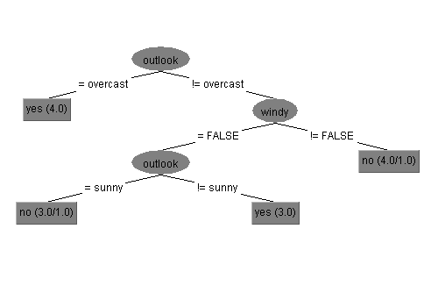
How Decision Trees Work
Notes:
Uses simple nested conditional structure
Tree structured
At each interior node we look at one feature
Value of this feature selects a sub-tree for making the rest of the decision (so edges are labeled with feature values)
At leaves we make a classification (assign the class)

Slide 70
How Decision Trees Work
Each interior node looks at one feature
Notes:
Uses simple nested conditional structure
Tree structured
At each interior node we look at one feature
Value of this feature selects a sub-tree for making the rest of the decision (so edges are labeled with feature values)
At leaves we make a classification (assign the class)

Slide 71
How Decision Trees Work
Feature value selects which subtree to traverse
Notes:
Uses simple nested conditional structure
Tree structured
At each interior node we look at one feature
Value of this feature selects a sub-tree for making the rest of the decision (so edges are labeled with feature values)
At leaves we make a classification (assign the class)

Slide 72
How Decision Trees Work
Leaves specify the classification
Notes:
Uses simple nested conditional structure
Tree structured
At each interior node we look at one feature
Value of this feature selects a sub-tree for making the rest of the decision (so edges are labeled with feature values)
At leaves we make a classification (assign the class)

Slide 73
Easy to train recursively
BuildTree(trainingSet)
// base case … (more base cases later)
If trainingSet only has one label on all instances
Return new Leaf(trainingSet.label)
// recursive case
Pick a feature Fn we haven’t split with before // … how?
result = new SplitNode(Fn)
For each value unique value f_{i} of feature Fn
trainSubset= subset of trainingSet with Fn= f_{i}
result.addChild(BuildTree(trainSubset))
Return result
(Note: “standard” algorithm is C4.5 [Quinlan 93])

Slide 74
Decision Trees
How do we pick features to base splits on?
Some features might be mostly noise (not very predictive of label)
splitting with doesn’t narrow down your decision much
Other features might have high information content
Notes:
Intuitively would like the features with the most information in them
Turns out there is a nice information theoretic way to estimate this: “Information Gain”
… will need a short trip into information theory

Slide 75
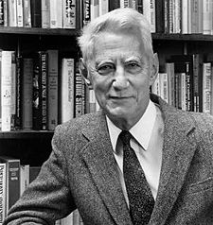
Information Entropy
(AKA Shannon Entropy):
a measure of uncertainty
Less uncertainty (less entropy) → more predictable → less information
Provides a lower bound on the average number of bits needed to encode / transmit something
Intuitively: proportional to how much information is in the thing to be transmitted
Claude Shannon (1916-2001) The father of information theory

Slide 76
Information Entropy
Assume a discrete random variable X w/ values {x₁,x₂…,x_{n}}
Uncertainty u_{i} associated with x_{i} (the number of bits needed to designate x_{i} in a message) defined as :
If X was uniformly distributed [P(x_{i}) = 1/n]:
u_{i} = log₂ n
For arbitrary non-uniform distribution:
u_{i} = log₂(1/P(x_{i})) = - log₂P(x_{i})
Entropy gives the average number of bits to encode a message of symbols drawn from X
Entropy(X) = H(X) = P(x₁) u₁+ P(x₂) u₂ +…+ P(x_{n}) u_{n}
= - ∑_{i=1..n} P(x_{i}) log₂ P(x_{i})

Slide 77
Information Entropy
Assume a discrete random variable X w/ values {x₁,x₂…,x_{n}}
Uncertainty u_{i} associated with x_{i} (the number of bits needed to designate x_{i} in a message) defined as :
If X was uniformly distributed [P(x_{i}) = 1/n]:
u_{i} = log₂ n
For arbitrary non-uniform distribution:
u_{i} = log₂(1/P(x_{i})) = - log₂P(x_{i})
Entropy gives the average number of bits to encode a message of symbols drawn from X
Entropy(X) = H(X) = P(x₁) u₁+ P(x₂) u₂ +…+ P(x_{n}) u_{n}
= - ∑_{i=1..n} P(x_{i}) log₂ P(x_{i})

Slide 78
Information Entropy
Assume a discrete random variable X w/ values {x₁,x₂…,x_{n}}
Uncertainty u_{i} associated with x_{i} (the number of bits needed to designate x_{i} in a message) defined as :
If X was uniformly distributed [P(x_{i}) = 1/n]:
u_{i} = log₂ n
For arbitrary non-uniform distribution:
u_{i} = log₂(1/P(x_{i})) = - log₂P(x_{i})
Entropy gives the average number of bits to encode a message of symbols drawn from X
Entropy(X) = H(X) = P(x₁) u₁+ P(x₂) u₂ +…+ P(x_{n}) u_{n}
= - ∑_{i=1..n} P(x_{i}) log₂ P(x_{i})

Slide 79
Information Entropy
Assume a discrete random variable X w/ values {x₁,x₂…,x_{n}}
Uncertainty u_{i} associated with x_{i} (the number of bits needed to designate x_{i} in a message) defined as :
If X was uniformly distributed [P(x_{i}) = 1/n]:
u_{i} = log₂ n
For arbitrary non-uniform distribution:
u_{i} = log₂(1/P(x_{i})) = - log₂P(x_{i})
Entropy gives the average number of bits to encode a message of symbols drawn from X
Entropy(X) = H(X) = P(x₁) u₁+ P(x₂) u₂ +…+ P(x_{n}) u_{n}
= - ∑_{i=1..n} P(x_{i}) log₂ P(x_{i})

Slide 80
Conditional Entropy
Specific Conditional Entropy
Entropy(F_{a} | F_{b} = x_{i})
Entropy of feature F_{a} among instances in which feature F_{b} = x_{i}
Conditional Entropy across the full training set
Entropy(Y | X): average specific conditional entropy of Y
Entropy in Y if X is known
Also expected number of bits to transmit Y if both sides already know the value of X
Entropy(Y | X) = ∑_{i=1..n} P(X= x_{i}) Entropy(Y | X = x_{i})

Slide 81
Information Gain (AKA Mutual Information or Kullback-Leibler divergence)
IG(Y | X) = Entropy(Y) – Entropy(Y | X) also given as IG(Y, X) and I(Y;X)
Reduction in entropy of Y (uncertainty about Y) by knowing X
If I need to transmit Y, how many bits on average would it save me if both sides already knew X
If I am predicting Y how much information does X provide
Case we are interested in: IG(Label | Feature)
Higher IG for a feature indicates more information about the label is in that feature
– Very useful for feature selection!

Slide 82
Impact on Decision Trees…
BuildTree(trainingSet)
// base case … (more base cases later)
If trainingSet only has one label on all instances
Return new Leaf(trainingSet.label)
// recursive case
Pick a feature Fn we haven’t split with before // … how?
result = new SplitNode(Fn)
For each value unique value f_{i} of feature Fn
trainSubset= subset of trainingSet with Fn= f_{i}
result.addChild(BuildTree(trainSubset))
Return result
(Note: “standard” algorithm is C4.5 [Quinlan 93])

Slide 83
Impact on Decision Trees…
BuildTree(trainingSet)
// base case … (more base cases later)
If trainingSet only has one label on all instances
Return new Leaf(trainingSet.label)
// recursive case
Pick a feature Fn we haven’t split with before // … how?
result = new SplitNode(Fn)
For each value unique value f_{i} of feature Fn
trainSubset= subset of trainingSet with Fn= f_{i}
result.addChild(BuildTree(trainSubset))
Return result
Split with feature having the largest IG
(Note: “standard” algorithm is C4.5 [Quinlan 93])

Slide 84
Impact on Decision Trees…
BuildTree(trainingSet)
// base case … (more base cases later)
If trainingSet only has one label on all instances
Return new Leaf(trainingSet.label)
// recursive case
Pick a feature Fn we haven’t split with before // … how?
result = new SplitNode(Fn)
For each value unique value f_{i} of feature Fn
trainSubset= subset of trainingSet with Fn= f_{i}
result.addChild(BuildTree(trainSubset))
Return result
Split with feature having the largest IG
… Stop when gain is small to avoid overfitting
(Note: “standard” algorithm is C4.5 [Quinlan 93])
Notes:
(Note: “standard” algorithm is C4.5 [Quinlan 93])

Slide 85
Decision Trees – Overfitting
Algorithm will subdivide all the way down to single training instances to exactly “fit” training data
But doing well on training data doesn’t guarantee doing well on new data
Small numbers of training instances don’t generalize well (“noisy”)
Decision trees are particularly prone to overfitting
“Pruning” can help (typically done after tree construction)

Slide 86
Minimum description length principle
The simplest model that fits your data will generalize better
Complex models are more likely to over-fit
Decision trees can become complex when you try to optimize performance on training data
Sometimes 0R/1R are best!
The best algorithm for your data will give you exactly the power you need

Slide 87
Prepruning versus Postpruning
Prepruning: knowing when to stop growing a tree
Hard to do because sometimes the value of a feature doesn’t become clear until lower down on the tree
Interactions between features
You always have to have a stopping criterion, so in some sense you are doing prepruning
But in practice you over-shoot and then do post-pruning

Slide 88
Prepruning versus Postpruning
Postpruning: simplifying a tree after it is built
Easier because hindsight is 20/20
Less efficient because you might have done a lot of work that you’re going to throw away now

Slide 89
Reduced Error Pruning
Estimate the error rate at each node of both the original and resulting tree (after pruning)
Prune when keeping the subtree means the error goes up on an optimization set
Won’t work to use the training set to compute the error rate because the original tree was optimized over this set already
You can hold back some of the training data for an optimization set to use for pruning

Slide 90
Using Confidence Factors to Estimate Error
Confidence factor = .25
Means you are 75% sure the error rate is within the interval.
(
)
Estimate error based on training data
If it is within the interval, prune
Notes:
Similar principle to computing confidence
Lowering the confidence value causes more pruning
We use the estimate “pessimistically” by using the upper confidence limit on the error estimate

Slide 91
Using Confidence Factors to Estimate Error
Confidence factor = .25
Means you are 75% sure the error rate is within the interval.
(
)
Estimate error based on training data
If it is within the interval, prune
Notes:
We use the estimate “pessimistically” by using the upper confidence limit on the error estimate

Slide 92
Lowering confidence causes more pruning
Confidence factor = .25
Means you are 75% sure the error rate is within the interval.
(
)
Confidence factor = .10
Means you are 90% sure the error rate is within the interval.
(
)
Lowering the confidence value causes more pruning
Notes:
Similar principle to computing confidence
Lowering the confidence value causes more pruning
We use the estimate “pessimistically” by using the upper confidence limit on the error estimate

Slide 93
Thinking about the Confidence Factor
More error expected: We’ve only used one feature to at this point
[10A, 10B]
[5A,1B]
[5A,10B]
Less error expected: We have used more information to make a decision
[5A,2B]
[0A,7B]
(
)
Confidence factor = .10: You are 90% sure the error rate is within the interval.

Slide 94
Thinking about the Confidence Factor
More error expected: We’ve only used one feature to at this point
[10A, 10B]
[5A,1B]
For the difference in errors, is |t| < |t| ?
[5A,10B]
Less error expected: We have used more information to make a decision
[5A,2B]
[0A,7B]
(
)
Confidence factor = .10: You are 90% sure the error rate is within the interval.
Notes:
If the difference is big enough then we feel it is worth the risk of additional complexity/overfitting
Otherwise we cannot conclude that the difference in accuracy is real

Slide 95
Decision Trees Pros and Cons
Open world assumption
Only examine some attributes
Beyond that can use the majority class to decide
Divide and conquer approach
Global maximization of performance at each iteration
Prone to overfitting. Pruning important for maximizing performance

Slide 96
Closed World Assumption
Presumes all true statements are known
Observer can thus make inferences about new things: if they are not known, they are false

Slide 97
Open World Assumption
No single observer has complete information
Observer can only make inferences about things that derive from things it already know to be true
represent information as we discover it and cannot guarantee that we know everything true
statements depending on unknown features are unknown rather than false

Slide 98
Example:
Statement: Jane is on the plane
Question: Is Paul on the plane?

Slide 99
Example:
Statement: Jane is on the plane
Question: Is Paul on the plane?
OWA: Unknown
CWA: No!

Slide 100
Example: Decision Trees
Contain statements about how features relate to outcomes
Question: What happens when an attribute is included that is not in the tree?
Notes:
Answer: Use the attributes you have and then use the majority class to decide …

Slide 101
From today’s reading
 | Decision Trees | Naïve Bayes | SVM* | Rule Learners
Accuracy in general | ** | * | **** | **
Speed of learning given f and n | *** | **** | * | **
Tolerance of missing values | *** | **** | **** | **
Tolerance of irrelevant features | *** | ** | *** | **
Tolerance of interdependent fs | ** | * | *** | **
Discrete/Binary/Continues fs | **** | *** (!cont) | ** (!disc) | *** (!cont)
Tolerance to noise | ** | *** | ** | *
Avoiding overfitting | ** | *** | ** | **
Intelligibility | **** | **** | ** | *
Notes:
Svm is a ‘better’ version of regression for classification
F = num features; n = num instances

Slide 102
From today’s reading
 | Decision Trees | Naïve Bayes | SVM* | Rule Learners
Accuracy in general | ** | * | **** | **
Speed of learning given f and n | *** | **** | * | **
Tolerance of missing values | *** | **** | **** | **
Tolerance of irrelevant features | *** | ** | *** | **
Tolerance of interdependent fs | ** | * | *** | **
Discrete/Binary/Continues fs | **** | *** (!cont) | ** (!disc) | *** (!cont)
Tolerance to noise | ** | *** | ** | *
Avoiding overfitting | ** | *** | ** | **
Intelligibility | **** | **** | ** | *
Notes:
Svm is a ‘better’ version of regression for classification
F = num features; n = num instances

Slide 103
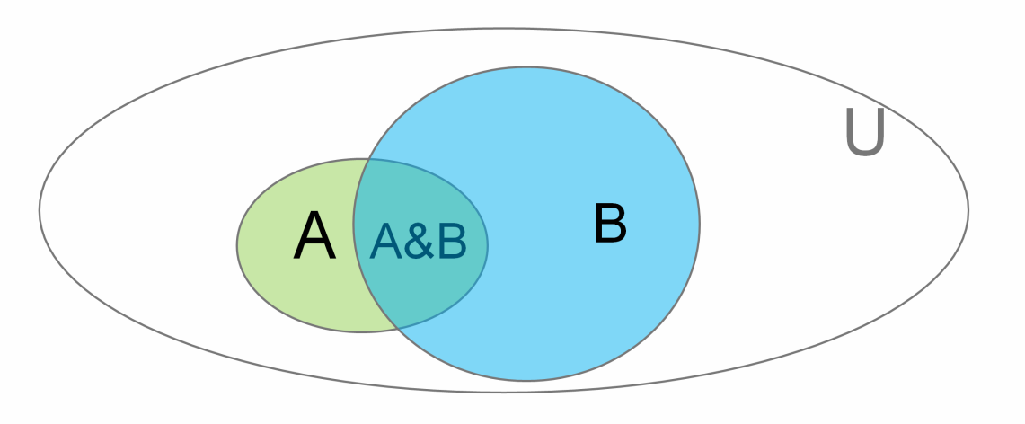
An Alternative: The Elegance of Statistics
We write P(A | B) to denote
“Probability of A given B” (or “… assuming B”)
or
“If we know B is true, what’s the probability of A”

Slide 104
Conditional Probability Example
Consider Jen’s Mobile data:
Location: {Shadyside, NSH, Hidden Valley, Other}
Activity: {Biking, Vehicle, Walking, Still, Other}
Conditional probabilities are useful in classification:
P(Walking| Location=Shadyside)
P(Sleeping | Location=NSH), etc
We can estimate these based on body of prior observations (e.g., count how many times walking when location was Shadyside)

Slide 105
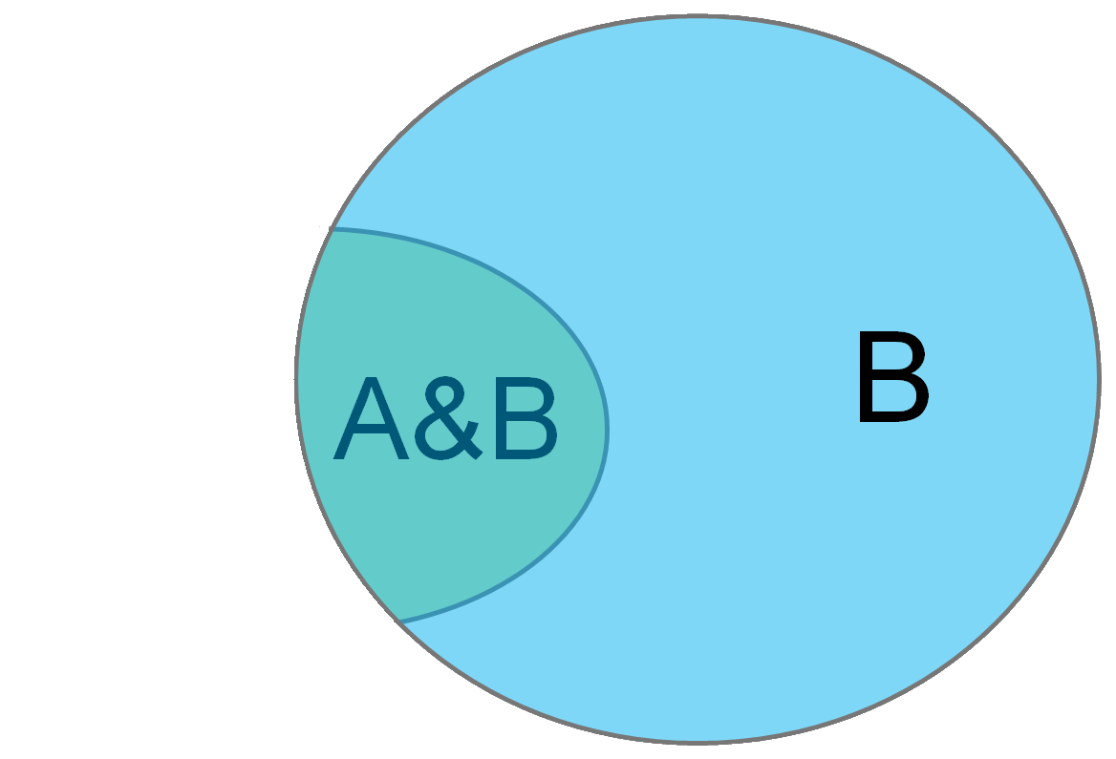
Conditional Probability
P(A | B) - “Probability of A given B”
You can think of this as just a change of universe
Probability of A treating B as the universe
→

Slide 106
Conditional Probability
P(A| B)
= |A&B|
|B|

Slide 107
Conditional Probability
P(A| B)
= |A&B|
|B|
Divide top and bottom by |U| …
|A&B|
= |U| = P(A&B)
|B| P(B)
|U|

Slide 108
Conditional Probability
P(Sleeping | NSH)
= P(Sleeping&NSH)
P(NSH)

Slide 109
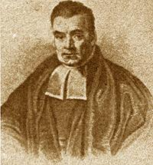
Naïve Bayes
Based on Bayes law
http://en.wikipedia.org/wiki/Bayes'_theorem
http://yudkowsky.net/rational/bayes
http://oscarbonilla.com/2009/05/visualizing-bayes-theorem/
Bayes Law (AKA Bayes theorem):
Rev. Thomas Bayes 1702-1761
P(B | A) P(A)
P(A | B) =
P(B)

Slide 110
Why is that true?

Slide 111
Why is that true?
P(A | B) = P(A&B)
P(B)

Slide 112
Why is that true?
P(A | B) = P(A&B)
P(B) → P(A | B)P(B)= P(A&B)

Slide 113
Why is that true?
P(A | B) = P(A&B)
P(B) → P(A | B)P(B)= P(A&B)
Now the converse
P(B | A) = P(A&B)
P(A) → P(B | A)P(A)= P(A&B)

Slide 114
Why is that true?
P(A | B) = P(A&B)
P(B) → P(A | B)P(B)= P(A&B)
Now the converse
P(B | A) = P(A&B)
P(A) → P(B | A)P(A)= P(A&B)
P(A | B)P(B) = P(B | A)P(A)

Slide 115
Why is that true?
P(A | B) = P(A&B)
P(B) → P(A | B)P(B)= P(A&B)
Now the converse
P(B | A) = P(A&B)
P(A) → P(B | A)P(A)= P(A&B)
P(A | B)P(B) = P(B | A)P(A) divide by P(B)

Slide 116
Why is that true?
P(A | B) = P(A&B)
P(B) → P(A | B)P(B)= P(A&B)
Now the converse
P(B | A) = P(A&B)
P(A) → P(B | A)P(A)= P(A&B)
P(A | B)P(B) = P(B | A)P(A) divide by P(B)
P(B | A) P(A)
P(A | B) =
P(B)

Slide 117
Bayes Law
Bayes Law (AKA Bayes theorem):
Rev. Thomas Bayes 1702-1761
P(B | A) P(A)
P(A | B) =
P(B)

Slide 118
Bayes Law
Bayes Law (AKA Bayes theorem):
Rev. Thomas Bayes 1702-1761
P(NSH | Sleeping) P(Sleeping)
P(Sleeping | NSH) =
P(NSH)

Slide 119
Naïve Bayes
Would like to know the probability that the true class is C_{i} given the occurrence of observed feature vector F = <f₁, f₂, …, f_{n} >
Compute as:
P(F | C_{i}) P(C_{i})
Likelihood * Prior
P(C_{i} | F) =
=
P(F)
Evidence

Slide 120
Naïve Bayes
Would like to know the probability that the true class is C_{i} given the occurrence of observed feature vector F = <f₁, f₂, …, f_{n} >
Compute as:
Class C_{x} with the highest computed probability is used as the classification result
P(F | C_{i}) P(C_{i})
Likelihood * Prior
P(C_{i} | F) =
=
P(F)
Evidence

Slide 121
Small Issues
What happens when C_{i} never occurs in the training data?
P(C_{i}) = 0, therefore C_{i} never wins & is never selected!
(Can insist C_{i} =1 to avoid this, but in general rare events can be hard to handle well)
We have implicitly assumed F_{k} comes from a discrete set e.g., so we can simply count the occurrences to compute P(F_{k} | C_{i})
Notes:
There are good ways to quantize (pick good “bins”) for e.g., numeric features automatically, but we won’t cover this

Slide 122
Naïve Bayes Pros and Cons
Elegant balance of features and prior probabilities
But depends on assumptions that are not in general true
Will tend to fail when things are highly conditional
i.e., System behaves very differently when X is true vs. Y is true
Works less well when attributes are redundant or classes are skewed (priors win)
Robust when features are missing (because of prior probabilities) (but not during training)
Notes:
In practice statistical approach doesn’t work better than “ad-hoc” methods
Closed world assumption: can make assumptions about things being ‘false’ [if not known]

Slide 123
From today’s reading
 | Decision Trees | Naïve Bayes | SVM* | Rule Learners
Accuracy in general | ** | * | **** | **
Speed of learning given f and n | *** | **** | * | **
Tolerance of missing values | *** | **** | **** | **
Tolerance of irrelevant features | *** | ** | *** | **
Tolerance of interdependent fs | ** | * | *** | **
Discrete/Binary/Continues fs | **** | *** (!cont) | ** (!disc) | *** (!cont)
Tolerance to noise | ** | *** | ** | *
Avoiding overfitting | ** | *** | ** | **
Intelligibility | **** | **** | ** | *
Notes:
Svm is a ‘better’ version of regression for classification
F = num features; n = num instances

Slide 124
Naïve Bayes vs Decision Trees
Decision Trees use contingencies between patterns of attribute values as a basis for decision making
Naïve Bayes treats attributes as independent pieces of evidence that the decision should go one way or another
Most of the time in real data sets the values of the different attributes are not independent of each other

Slide 125
Review: Decision Trees & Naïve Bayes
Minimum description length principal
Decision trees are simple and easily learned
Add nodes based on information gain
Naïve Bayes pros
Takes priors into account
Robust even when features are missing
Naïve Bayes cons
Assumptions: Independence; Closed world
Fails when things are highly conditional
Fails when data is highly skewed

Slide 126
Need to add slides on regression and maybe unsupervised learning/clustering

Slide 127
Example: Stepgreen data

Slide 128
Actions that don’t change
Rank | Already Do | Unappealing
1 | Turn out lights when leaving home (16%) | Install motion sensors for some lights (5%)
2 | Use a manual toothbrush (12%) | Turn off and unplug devices at work (5%)
3 | Turn out lights when leaving a room (12%) | Volunteer time (5%)
Notes:
These actions don’t change, meaning that many users either already did them or didn’t plan on committing them
Already Do: Top 3 actions already done based on %age of users who marked them in each category in our open deployment.
Unappealing: examples of actions few committed to/already do.

Slide 129
Popular, High Impact New Actions
Name | Impact
Set your home computer to sleep | 617 lbs CO₂/yr
Recycle aluminum | 116 lbs CO₂/yr
Adjust your water heater thermostat to 120F | 1242 lbs CO₂/yr
Notes:
These actions represent change – new things that people committed to
These are examples taken from the top 10 new actions. On average, users commited to about 8 new actions after reporting what they already do.

Slide 130
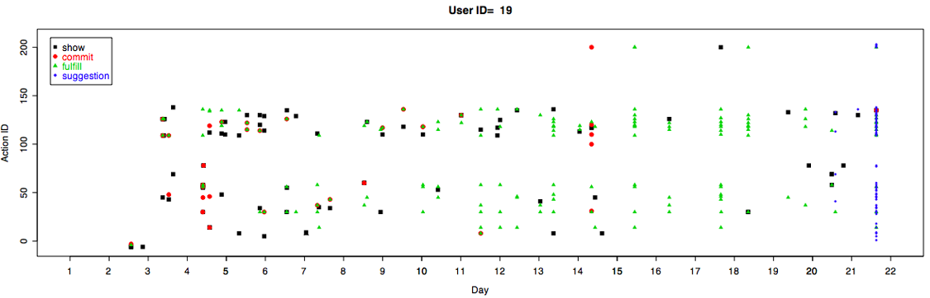
Digging Deeper…
Patterns of learning, commitment, fulfillment, getting suggestions
Notes:
One pair of participants frequently and reciprocally visited each others’ pages (7 and 15 times). One other participant frequently visited a friend’s page that did not reciprocate .
1 user reported talking about the site with friends in the same study to remind each other to log in every day (P26 I think). She would have liked to have her friends represented on her visualization.
In our interviews , ten participants told us that they showed the site to others. Communication about the site happened through diverse channels. In some cases, it happened through shared physical spaces. One participant and her 14 year old daughter had a joint MySpace account. The daughter started helping to remind that participant to follow through on her commitments. Two other participants reported showing the site to their partners or housemates.
Two participants reported that multiple friends contacted them by IM with questions and one participant reported getting questions directly on her MySpace. Six friends of participants went as far as clicking on the “Sign Up” link and one requested an account after clicking through to the StepGreen main site.
We did not interview everyone. Probably only 15-20 people. E.g. I only see explicit mention of sharing from about 15 to 20 people total, not 32
Do individual/ethnic differences influence these trajectories?

Slide 131
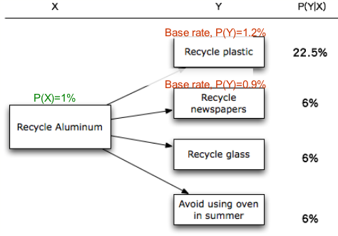
Predicting Next Committed Action- Recycling
Notes:
There are many uses for our data planned in the future. This slide is just one example – developing predictive models that can help us make meaningful recommendations to users.
Based on data from this study, we may predict what’s the next action that a user would commit to based on the current commitment.
So for a user who committed to Recycle Aluminum, about 20% of time she will commit to recycling plastic next.
Note that the base rate for committing “recycle plastic” was only about 1%. So knowing whether the user committed to recycle aluminum is useful in making predictions.
This can be a basis for recommending suitable actions to users

Slide 132
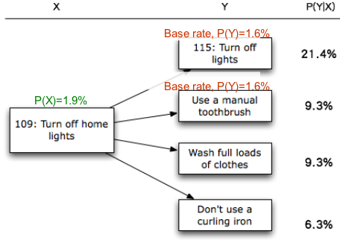
Predicting Next Committed Action- Turning off lights
Notes:
Here is another example.
Similarly, if one committed to turn off home lights, it’s likely that she’ll commit to turn off lights in general and use a manual toothbrush.
The recommendation could be done in two ways. First, we may recommend the actions that one’s likely to commit to, so we lower users’ overhead in searching for actions and promote the system’s usability. Second, we may identify what energy-saving actions are less likely to be considered by the user, and we may try to advertise and promote those actions through various ways. Overall, we might perform more adaptive, strategic persuasion based on the information.

Slide 134
The Data Set
There are a number of public data sets on BigQuery. You can use any of them
We focus on the natality data set
https://cloud.google.com/bigquery/docs/dataset-natality
“All births registered in the 50 States, DC, and NYC from 1969 to 2008. The CDC receives these data as electronic files, prepared from individual records processed by each registration area…”

Slide 135
Example: Natality Data Set
Field Name | Type | Description
alcohol_use | BOOL | True if the mother used alcohol. Available starting 1989
apgar_1min | INT | Apgar scores measure the health of a newborn child on a scale from 0-10. Value after 1 minute. Available from 1978-2002.
apgar_5min | INT | Apgar scores measure the health of a newborn child on a scale from 0-10. Value after 5 minutes. Available from 1978-2002.
born_alive_alive | INT | Number of children previously born to the mother who are now living.
born_alive_dead | INT | Number of children previously born to the mother who are now dead.
…

Slide 136
Natality Data Set
…
Field Name | Type | Description
plurality | INT | How many children were born as a result of this pregnancy. twins=2, triplets=3, and so on.
state | STR | The two character postal code for the state. Entries after 2004 do not include this value.
wday | INT | Day of the week, where 1 is Sunday and 7 is Saturday.
weight_gain_pounds | FLOAT | Number of pounds gained by the mother during pregnancy.
weight_pounds | FLOAT | Weight of the child, in pounds.
year | INT | Four-digit year of the birth. Example: 1975.
https://cloud.google.com/bigquery/docs/dataset-natality
Notes:
Discuss how to pick appropriate features and talk about some of these and whether or not they are ok to use…

Slide 137
After applying logistic regression:
drinks_per_week : 10.4458435228
born_alive_alive : 5.10540437526
born_alive_dead : 0.201596177591
father_age : 158.603348865
mother_age : 145.833818566
weight_gain_pounds : 145.577879963
year : 9944.99904843
… [I had other features too in this]
accuracy : 0.91249999999999998
Notes:
Discuss year
Discuss variations among these features
Discuss accuracy …

Slide 138
Logistic regression
But we are learning
We have a training set (X₁,y₁)…(X_{n},y_{n}) of feature vectors X and prediction y pairs.
And we are trying to learn W (weights for the features), also called θ sometimes, by minimizing the error E(W)
Notes:
an upper bound on mis-classification error

Slide 139
Logistic regression: Review
we want to minimize an error term based on w
When E(w) is minimized we have our best fit
Notes:
an upper bound on mis-classification error

Slide 140
Regression for big data
Batch mode : Gradient Descent
w_{j} = w_{i} - η Δ(w) over the entire data S
Difficult to parallelize

Slide 141
How do we handle big data
Batch mode : Gradient Descent
w_{j} = w_{i} - η Δ(w) over the entire data S
Incremental mode: stochastic gradient descent
w_{j} = w_{i} - η * approximation of Δ(w) based on t_{x}-o_{d}
(difference between ideal target value and w^{T}x)

Slide 142
How do we handle big data
Batch mode : Gradient Descent
w_{j} = w_{i} - η Δ(w) over the entire data S
Incremental mode: stochastic gradient descent
w_{j} = w_{i} - η * approximation of Δ(w) based on t_{x}-o_{d}
Instead of:
Use:
For every y
Notes:
Note: may not converge to the minimum…

Slide 143
How do we handle big data
Batch mode : Gradient Descent
w_{j} = w_{i} - η Δ(w) over the entire data S
Incremental mode: stochastic gradient descent
w_{j} = w_{i} - η * approximation of Δ(w) based on t_{x}-o_{d}
can approximate Batch Gradient Descent arbitrarily closely if η is small enough
supports online learning
easily parallelized
Not guarranteed to reach global minimum

Slide 144
Small Data version
# weights -- the list weights currently assigned to the features (an empty array that will be filled in by this function. # X -- the array containing cases to predict from, # labels -- the ground truth y values. # step -- the rate controller for changing the weights. # lam -- the regularization parameter. Something you could play with on a large data set is what value to use for this. you would want to do that by picking an optimization set and trying lots of lam values (from 0 to 1) on that optimization set. # iterations -- defaults to 1 for stochastic gradient descent, but can be higher in standard gradient descent.
def gradient_descent(self, weights, X, y_labels, step=0.1, lam=0.1, iterations=1): m, n=X.shape # iterate over the rows to train the model on the same data for i in xrange(iterations): for r in xrange(_MAX_ROWS): old_weights = weights weights = old_weights + step*(self.loss_func(X[r], old_weights - y_labels[r]))*X[r] #add in regularization term weights = weights - lam*2.*step*old_weights return weight

Slide 145
Stochastic Version
def stochastic_gradient_descent(self, features, predict, prediction_test, zeros_string, ones_string, batch=10):
weights = np.random.random(len(features)+1)
# Technically, we would do only one x at each round, but we can load subsets of the data and do multiple rows at each round. _MAX_ROWS determines how much data is loaded at each iteration. for i in xrange(batch):
# get _MAX_ROWS of examples of bad births and good births (equal amounts of each). This is so we have lots of examples of both types bad_births, bad_births_labels = self.get_data(features, predict, prediction_test, zeros_string) good_births, good_births_labels = self.get_data(features, predict, prediction_test, ones_string)
# combine them into one data set y_labels = np.concatenate([bad_births_labels, good_births_labels]) X = np.concatenate([bad_births, good_births])
# the resulting weights weights = self.gradient_descent(weights, X, y_labels)
model = lambda x: 1-self.loss_func(x, weights)<.5
return weights, model

Slide 146
Stochastic Version
def stochastic_gradient_descent(self, features, predict, prediction_test, zeros_string, ones_string, batch=10):
weights = np.random.random(len(features)+1)
# Technically, we would do only one x at each round, but we can load subsets of the data and do multiple rows at each round. _MAX_ROWS determines how much data is loaded at each iteration. for i in xrange(batch):
# get _MAX_ROWS of examples of bad births and good births (equal amounts of each). This is so we have lots of examples of both types bad_births, bad_births_labels = self.get_data(features, predict, prediction_test, zeros_string) good_births, good_births_labels = self.get_data(features, predict, prediction_test, ones_string)
# combine them into one data set y_labels = np.concatenate([bad_births_labels, good_births_labels]) X = np.concatenate([bad_births, good_births])
# the resulting weights weights = self.gradient_descent(weights, X, y_labels)
model = lambda x: 1-self.loss_func(x, weights)<.5
return weights, model
How many times to loop. The default is small for debugging purposes.
Notes:
needs to run repeatedly, pulling new data each time
it incorporates calls to get_data inside its loop and it needs
batch is the number of times to run this (make it small when debugging)

Slide 147
Stochastic Version
def stochastic_gradient_descent(self, features, predict, prediction_test, zeros_string, ones_string, batch=10):
weights = np.random.random(len(features)+1)
# Technically, we would do only one x at each round, but we can load subsets of the data and do multiple rows at each round. _MAX_ROWS determines how much data is loaded at each iteration. for i in xrange(batch):
# get _MAX_ROWS of examples of bad births and good births (equal amounts of each). This is so we have lots of examples of both types bad_births, bad_births_labels = self.get_data(features, predict, prediction_test, zeros_string) good_births, good_births_labels = self.get_data(features, predict, prediction_test, ones_string)
# combine them into one data set y_labels = np.concatenate([bad_births_labels, good_births_labels]) X = np.concatenate([bad_births, good_births])
# the resulting weights weights = self.gradient_descent(weights, X, y_labels)
model = lambda x: 1-self.loss_func(x, weights)<.5
return weights, model
We need new labels and rows each time we loop. self.get_data retrieves data from big_query for us

Slide 148
get_data
# a helper function for retrieving data from the database and putting it into # the right format for machine learning. def get_data(self, features, predict, prediction_test, filter=None, limit=_MAX_ROWS):
# need to retrieve data from bigquery query_string = self.make_query_string(features, predict, filter, limit)
…
# y are the labels -- the values we are predicting y = np.array(labels)
# X are the features -- the values we use to make the prediction X = np.array(data)
return X, y

Slide 149
get_data
# a helper function for retrieving data from the database and putting it into # the right format for machine learning. def get_data(self, features, predict, prediction_test, filter=None, limit=_MAX_ROWS):
# need to retrieve data from bigquery query_string = self.make_query_string(features, predict, filter, limit)
…
# y are the labels -- the values we are predicting y = np.array(labels)
# X are the features -- the values we use to make the prediction X = np.array(data)
return X, y
get_data returns two variables: A vector of labels, and an array of values.

Slide 150
get_data
get_data depends on make_query_string
# a helper function for retrieving data from the database and putting it into # the right format for machine learning. def get_data(self, features, predict, prediction_test, filter=None, limit=_MAX_ROWS):
# need to retrieve data from bigquery query_string = self.make_query_string(features, predict, filter, limit)
…
# y are the labels -- the values we are predicting y = np.array(labels)
# X are the features -- the values we use to make the prediction X = np.array(data)
return X, y

Slide 151
get_data
get_data depends on make_query_string
# a helper function for retrieving data from the database and putting it into # the right format for machine learning. def get_data(self, features, predict, prediction_test, filter=None, limit=_MAX_ROWS):
# need to retrieve data from bigquery query_string = self.make_query_string(features, predict, filter, limit)
…
# y are the labels -- the values we are predicting y = np.array(labels)
# X are the features -- the values we use to make the prediction X = np.array(data)
return X, y
make_query_string constructs a query string out of the features

Slide 152
get_data
get_data depends on make_query_string
# a helper function for retrieving data from the database and putting it into # the right format for machine learning. def get_data(self, features, predict, prediction_test, filter=None, limit=_MAX_ROWS):
# need to retrieve data from bigquery query_string = self.make_query_string(features, predict, filter, limit)
…
# y are the labels -- the values we are predicting y = np.array(labels)
# X are the features -- the values we use to make the prediction X = np.array(data)
return X, y
make_query_string constructs a query string out of the features, class to be predicted

Slide 153
get_data
get_data depends on make_query_string
# a helper function for retrieving data from the database and putting it into # the right format for machine learning. def get_data(self, features, predict, prediction_test, filter=None, limit=_MAX_ROWS):
# need to retrieve data from bigquery query_string = self.make_query_string(features, predict, filter, limit)
…
# y are the labels -- the values we are predicting y = np.array(labels)
# X are the features -- the values we use to make the prediction X = np.array(data)
return X, y
make_query_string constructs a query string out of the features, class to be predicted, and a filter (for things unwanted)

Slide 154
get_data
get_data depends on make_query_string
# a helper function for retrieving data from the database and putting it into # the right format for machine learning. def get_data(self, features, predict, prediction_test, filter=None, limit=_MAX_ROWS):
# need to retrieve data from bigquery query_string = self.make_query_string(features, predict, filter, limit)
…
# y are the labels -- the values we are predicting y = np.array(labels)
# X are the features -- the values we use to make the prediction X = np.array(data)
return X, y
make_query_string constructs a query string out of the features, class to be predicted, and a filter (for things unwanted), limited to [limit] rows of results.

Slide 155
get_data
get_data depends on make_query_string
# a helper function for retrieving data from the database and putting it into # the right format for machine learning. def get_data(self, features, predict, prediction_test, filter=None, limit=_MAX_ROWS):
# need to retrieve data from bigquery query_string = self.make_query_string(features, predict, filter, limit)
…
# y are the labels -- the values we are predicting y = np.array(labels)
# X are the features -- the values we use to make the prediction X = np.array(data)
return X, y
An example filter is: "row_number % 2 = 1 AND apgar_1min < 7”
The first part of this specifies that we only use odd rows (for training) and the second part specifies the apgar values should only match one class.

Slide 156
Stochastic Version
def stochastic_gradient_descent(self, features, predict, prediction_test, zeros_string, ones_string, batch=10):
weights = np.random.random(len(features)+1)
# Technically, we would do only one x at each round, but we can load subsets of the data and do multiple rows at each round. _MAX_ROWS determines how much data is loaded at each iteration. for i in xrange(batch):
# get _MAX_ROWS of examples of bad births and good births (equal amounts of each). This is so we have lots of examples of both types bad_births, bad_births_labels = self.get_data(features, predict, prediction_test, zeros_string) good_births, good_births_labels = self.get_data(features, predict, prediction_test, ones_string)
# combine them into one data set y_labels = np.concatenate([bad_births_labels, good_births_labels]) X = np.concatenate([bad_births, good_births])
# the resulting weights weights = self.gradient_descent(weights, X, y_labels)
model = lambda x: 1-self.loss_func(x, weights)<.5
return weights, model
These strings help specify details needed to make the right query on the database. We want an equal number of examples of each class for training.
We need new labels and values each time we loop. self.get_data retrieves data from big_query for us
Notes:
Note that this choice is arguable, since the data is skewed we may want to keep that in mind during testing…

Slide 157
Stochastic Version
def stochastic_gradient_descent(self, features, predict, prediction_test, zeros_string, ones_string, batch=10):
weights = np.random.random(len(features)+1)
# Technically, we would do only one x at each round, but we can load subsets of the data and do multiple rows at each round. _MAX_ROWS determines how much data is loaded at each iteration. for i in xrange(batch):
# get _MAX_ROWS of examples of bad births and good births (equal amounts of each). This is so we have lots of examples of both types bad_births, bad_births_labels = self.get_data(features, predict, prediction_test, zeros_string) good_births, good_births_labels = self.get_data(features, predict, prediction_test, ones_string)
# combine them into one data set y_labels = np.concatenate([bad_births_labels, good_births_labels]) X = np.concatenate([bad_births, good_births])
# the resulting weights weights = self.gradient_descent(weights, X, y_labels)
model = lambda x: 1-self.loss_func(x, weights)<.5
return weights, model
Note that most of the parameters to stochastic_gradient_descent are really there to support the call to get_data…

Slide 158
Stochastic Version
def stochastic_gradient_descent(self, features, predict, prediction_test, zeros_string, ones_string, batch=10):
weights = np.random.random(len(features)+1)
# Technically, we would do only one x at each round, but we can load subsets of the data and do multiple rows at each round. _MAX_ROWS determines how much data is loaded at each iteration. for i in xrange(batch):
# get _MAX_ROWS of examples of bad births and good births (equal amounts of each). This is so we have lots of examples of both types bad_births, bad_births_labels = self.get_data(features, predict, prediction_test, zeros_string) good_births, good_births_labels = self.get_data(features, predict, prediction_test, ones_string)
# combine them into one data set y_labels = np.concatenate([bad_births_labels, good_births_labels]) X = np.concatenate([bad_births, good_births])
# the resulting weights weights = self.gradient_descent(weights, X, y_labels)
model = lambda x: 1-self.loss_func(x, weights)<.5
return weights, model
Here we call good old regular gradient descent to produce a set of weights for the features

Slide 159
Stochastic Version
def stochastic_gradient_descent(self, features, predict, prediction_test, zeros_string, ones_string, batch=10):
weights = np.random.random(len(features)+1)
# Technically, we would do only one x at each round, but we can load subsets of the data and do multiple rows at each round. _MAX_ROWS determines how much data is loaded at each iteration. for i in xrange(batch):
# get _MAX_ROWS of examples of bad births and good births (equal amounts of each). This is so we have lots of examples of both types bad_births, bad_births_labels = self.get_data(features, predict, prediction_test, zeros_string) good_births, good_births_labels = self.get_data(features, predict, prediction_test, ones_string)
# combine them into one data set y_labels = np.concatenate([bad_births_labels, good_births_labels]) X = np.concatenate([bad_births, good_births])
# the resulting weights weights = self.gradient_descent(weights, X, y_labels)
model = lambda x: 1-self.loss_func(x, weights)<.5
return weights, model
Lastly we construct a function that can take an example and make a prediction from it
Notes:
(we return both of them)

Slide 160
Applying the model
weights, regression_model = self.stochastic_gradient_descent(features, predict, self.apgar_1min_test, zeros_string, ones_string)
# testing_X is the data we will use to make predictions, labels are the ground truth (correct) y values. The test makes sure we are getting data for which the row numbers are even) testing_X, labels = self.get_data(features, predict, self.apgar_1min_test, filter="row_number % 2 = 0", limit=100)
# apply_model can apply any model (a model is just a function that can predict a value). it returns an accuracy
regression_accuracy = self.apply_model(regression_model, testing_X, labels)
Call stochastic_gradient_descent to train the model. Recall that it returns a function (the model)

Slide 161
Applying the model
weights, regression_model = self.stochastic_gradient_descent(features, predict, self.apgar_1min_test, zeros_string, ones_string)
# testing_X is the data we will use to make predictions, labels are the ground truth (correct) y values. The test makes sure we are getting data for which the row numbers are even) testing_X, labels = self.get_data(features, predict, self.apgar_1min_test, filter="row_number % 2 = 0", limit=100)
# apply_model can apply any model (a model is just a function that can predict a value). it returns an accuracy
regression_accuracy = self.apply_model(regression_model, testing_X, labels)
Here we need to cerate a test set. We use the even row numbers for our filter
Notes:
this is the half of our data we will use for testing, odd numbers are reserved for training)

Slide 162
Applying the model
weights, regression_model = self.stochastic_gradient_descent(features, predict, self.apgar_1min_test, zeros_string, ones_string)
# testing_X is the data we will use to make predictions, labels are the ground truth (correct) y values. The test makes sure we are getting data for which the row numbers are even) testing_X, labels = self.get_data(features, predict, self.apgar_1min_test, filter="row_number % 2 = 0", limit=100)
# apply_model can apply any model (a model is just a function that can predict a value). it returns an accuracy
regression_accuracy = self.apply_model(regression_model, testing_X, labels)
Here we apply the model to the test set using apply_model, which simply applies the model to each row in testing_X and then calculates accuracy

Slide 163
What you need to do
weights, regression_model = self.stochastic_gradient_descent(features, predict, self.apgar_1min_test, zeros_string, ones_string)
# testing_X is the data we will use to make predictions, labels are the ground truth (correct) y values. The test makes sure we are getting data for which the row numbers are even) testing_X, labels = self.get_data(features, predict, self.apgar_1min_test, filter="row_number % 2 = 0", limit=100)
# apply_model can apply any model (a model is just a function that can predict a value). it returns an accuracy
regression_accuracy = self.apply_model(regression_model, testing_X, labels)
1) You will need to update apply_model to also return a precision and recall score.

Slide 164
What you need to do
weights, regression_model = self.stochastic_gradient_descent(features, predict, self.apgar_1min_test, zeros_string, ones_string)
# testing_X is the data we will use to make predictions, labels are the ground truth (correct) y values. The test makes sure we are getting data for which the row numbers are even) testing_X, labels = self.get_data(features, predict, self.apgar_1min_test, filter="row_number % 2 = 0", limit=100)
# apply_model can apply any model (a model is just a function that can predict a value). it returns an accuracy
regression_accuracy = self.apply_model(regression_model, testing_X, labels)
# TODO: this is something you should implement yourself. zeror_model = self.zeror_train(features, predict, self.apgar_1min_test) zeror_accuracy = self.apply_model(zeror_model, testing_X, labels)
In addition, you should write a zeror_train function which returns a model that always predicts the majority class. This will require that you count how many rows have apgar_1min < 7 (vs >= 7) and then return a function that uses this information to make the same prediction no matter what features it is passed.

Slide 165
What you need to do
weights, regression_model = self.stochastic_gradient_descent(features, predict, self.apgar_1min_test, zeros_string, ones_string)
# testing_X is the data we will use to make predictions, labels are the ground truth (correct) y values. The test makes sure we are getting data for which the row numbers are even) testing_X, labels = self.get_data(features, predict, self.apgar_1min_test, filter="row_number % 2 = 0", limit=100)
# apply_model can apply any model (a model is just a function that can predict a value). it returns an accuracy
regression_accuracy = self.apply_model(regression_model, testing_X, labels)
# TODO: this is something you should implement yourself. zeror_model = self.zeror_train(features, predict, self.apgar_1min_test) zeror_accuracy = self.apply_model(zeror_model, testing_X, labels)
If you do that correctly, apply_model will just work for this model as it does for the regression model. Then you can compare the accuracies…

Slide 166
What you need to do
weights, regression_model = self.stochastic_gradient_descent(features, predict, self.apgar_1min_test, zeros_string, ones_string)
# testing_X is the data we will use to make predictions, labels are the ground truth (correct) y values. The test makes sure we are getting data for which the row numbers are even) testing_X, labels = self.get_data(features, predict, self.apgar_1min_test, filter="row_number % 2 = 0", limit=100)
# apply_model can apply any model (a model is just a function that can predict a value). it returns an accuracy
regression_accuracy = self.apply_model(regression_model, testing_X, labels)
# TODO: this is something you should implement yourself. zeror_model = self.zeror_train(features, predict, self.apgar_1min_test) zeror_accuracy = self.apply_model(zeror_model, testing_X, labels)
If you do that correctly, apply_model will just work for this model as it does for the regression model. Then you can compare the accuracies…

Slide 167
Extra things you can explore
Try creating an optimization set in addition to the test set
Try experiments in varying the features used, lambda, and so on using that set
Add ajax support and show the improvement live during gradient descent
Implement a user interface that lets someone use the model to make a prediction
Explore a different data set
Use Google’s prediction API (on cloud storage)
Notes:
(could use %3 to do this if you want it in 3rds, or %9 and then group things in various ways)

